Slide 1

Java Advanced
Course Introduction
SoftUni Team
Technical Trainers
Software University
http://softuni.bg

Slide 2
Table of Content
Course Objectives & Program
The Trainers Team
Course Organization
Homework
Exam
Resources

Slide 3
Have a Question?
sli.do #java-fund

Slide 4

Java Advanced
Course Objective & Program

Slide 5
Course Objectives
Java is Everywhere
Wonderful Community Support
Java is Platform Independent
Excellent documentation support - Javadocs
Great collection of Open Source libraries
Java has Rich API

Slide 6



Course Topics
Stack and Queues
Multidimensional Arrays
Sets and Maps
Streams, Files and Directories
Functional Programming
Defining Classes
Workshop – Create Simple Data Structure
Generics
Iterators and Comparators
Workshop

Slide 7

The Trainers Team

Slide 8

Trainers Team
Nikolai Bankin
Top performing student from the Software University (2014)
4 years of programming experience mainly with Java, PHP, HTML, CSS and JavaScript
Teacher at TUES

Slide 9
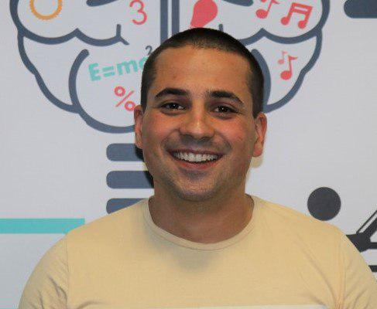
Trainers Team
Martin Paunov
Junior Automatization Programmer
Experience with Java, C++, C#
Technical Trainer @ SoftUni
Interested in Astrophysics

Slide 10

Course Organization

Slide 11
Java Fundamentals Module – Timeline
15-January-2019
26-February-2019
16-18-April-2019
Java Advanced
6 weeks * 4 times / week
12 credits
Start: 15-Jan-2019
Final exam: 24-Feb-2019
Java OOP
7 weeks * 4 times / week
15 credits
Start: 26-Feb-2019
Final exam: 14-April-2019
Re-Take Exams
TBA

Slide 12



Scoring System for the Course
Presence in class 5%
Homework 15%
Evaluation
Forum Activity 5%
Exam 85%

Slide 13

Homework Assignments & Exercises
Your homework is mainly work in class!
Lesson days → slides + live demos + exercises
Exercise days → only exercises
How to submit your homework?
Submitted in the judge system
Do your homework when it's due!
Assignments pile up quickly

Slide 14
Exam
Practical programming Exam
3 practical problems for 4 hours:
Code in Java
Problem 1: Data Structures (Stack, Queues, Sets, Maps)
Problem 2: Multidimensional Arrays
Problem 3: Defining Classes

Slide 15
Resources
Resources
What We Need Additionally?

Slide 16



Java DB Course Web Site, Forum and FB Group
Official web site:
Official discussion forum:
Official Facebook groups:
https://softuni.bg/trainings/2246/java-advanced-january-2019
https://softuni.bg/forum/categories/7/java-advanced
https://www.facebook.com/groups/JavaFundamentalsJanuary2019/

Slide 17


The DB Basics MySQL Slides and Videos
All lecture slides, videos, homework assignments, projects and other resources are open content, available for free
Visit the course web site to access the course resources

Slide 18

Java DB Recommended Software
Software needed for this course:
Microsoft Windows 10
IntelliJ Idea - https://www.jetbrains.com/idea/

Slide 19



Learn to Search in Internet
The course assignments require to search in Internet
This is an important part of the learning process
Some exercises intentionally have no hints
Learn to find solutions!
Software development includes everyday searching and learning
No excuses, just learn to study!
Developers learn new technologies, tools, languages every day!

Slide 20
https://softuni.bg/trainings/courses

Slide 21












SoftUni Diamond Partners

Slide 22




SoftUni Organizational Partners

Slide 23




Trainings @ Software University (SoftUni)
Software University – High-Quality Education and Employment Opportunities
softuni.bg
Software University Foundation
http://softuni.foundation/
Software University @ Facebook
facebook.com/SoftwareUniversity
Software University Forums
forum.softuni.bg

Slide 24

License
This course (slides, examples, demos, videos, homework, etc.) is licensed under the "Creative Commons Attribution-NonCommercial-ShareAlike 4.0 International" license

